Slide 1
GBIC2 – Closing session
Donald Hobern, GBIF Executive Secretary
Macropus robustus Gould, 1841, subspecies erubescens, Euro, Denham, WA, Australia, 10 January 2018

Slide 2

COALITION of OPEN BIODIVERSITY INFRASTRUCTURES AND NETWORKS
We are a network of infrastructures, institutions, agencies, societies and researchers which wish to collaborate more effectively to develop, adopt and promote models and approaches that support seamless and comprehensive generation, management and accessibility for information relating to all aspects of the world’s biodiversity, at all scales and levels of organization, in multilingual forms and in ways that address the needs of all interested users and communities in all regions, and thereby to support the needs of science and society.
http://biodiversityinformatics.org/

Slide 3
Shared Challenges – 1 of 3
To deliver biodiversity knowledge and understanding in forms which support critical research requirements and enable biodiversity to be correctly measured and valued for societal goals
To enable participation of all stakeholder groups in all regions as full collaborators at all stages from data generation to analysis and use
To remove barriers to free and open sharing of data and to adoption of FAIR principles for biodiversity data
To mobilise structured digital representations of historical data sources and to ensure new observations and measurements are born digital
To describe all data resources with rich metadata to support present and future reuse
To ensure all data resources are preserved in stable persistent repositories
http://biodiversityinformatics.org/

Slide 4
Shared Challenges – 2 of 3
To enable collaborative curation, annotation and improvement of all data by any relevant expert communities
To enable different classes of biodiversity information (distribution, traits, genes, etc.) to be combined, queried and analysed together
To work with other research data infrastructures to achieve interoperability with earth-observing, social science and other resources
To track provenance and attribution for all sources of information
To enable all contributions of knowledge or expertise to be recorded, acknowledged and credited to the contributor
To ensure effective access and application of data at global, regional, national and local scales
To support the place of national and local investments as effective components within a global solution
http://biodiversityinformatics.org/

Slide 5
Shared Challenges – 3 of 3
To overcome barriers to data sharing or use arising from language or culture
To address capacity needs around biodiversity informatics in all regions and in all sectors
To secure funding to maintain services and infrastructures recognised by the coalition as critical components within our digital ecosystem
To develop flexible collaborative approaches to designing, building and sustaining all components of our digital ecosystem
To enable stakeholders in every country and region to adopt and benefit from advances in infrastructure, tools, practices and capacity
To deliver robust and flexible solutions, appropriate for all stakeholders, for taxonomic and phylogenetic sharing, organization and access for data relating to any species
http://biodiversityinformatics.org/

Slide 6
Lightweight coalitION
All coalition partners will be equal stakeholders in developing vision and plans
GBIF Secretariat will provide initial facilitation and support to:
Develop and publicise paper outlining vision for coalition
Establish mailing list and website for comments and for declarations of support
Seek funding for initial tasks, workshops and engagements with other communities
Need a suitable name – should indicate clearly the lightweight intent
Need to determine whether we should place any limits on individual or organisational declarations of support
http://biodiversityinformatics.org/

Slide 7
Initial TASk 1 – Defining QUESTIONS
Should provide testable criteria for evaluating progress in delivering infrastructure
Should be realistic and relate to real requirements
Should include capability goals
E.g. A knowledgeable taxonomist should be able to gain access directly to correct mistakes in handling of scientific names
Should include exemplar research questions
E.g. Is there a latitudinal signal in insect wing-lengths, and is it consistent across insect orders?
Should include policy/societal questions
E.g. Given existing land use and expected effects of climate change in the next 25 years, which of two possible configurations of protected areas and arable use areas is expected best to maximise survival of wild species currently found in the area?
Should include questions to assess coverage and completeness
E.g. Do existing data allow comparison between two time periods between the area of occupancy on a 5kmx5km grid for at least 75% of reptile species recorded from a region, at greater than 95% confidence?
Consider having some extra questions for specific regions
Can use coalition website/mailing lists to gather key questions
Need to engage directly with key contributor and user communities to get their perspectives – e.g. IAPT, CETAF, ICZN, IUCN, GEO BON, IPBES, CBD, selection of national and local initiatives
Should develop a process for collecting, organising and refining questions
Should include assessment of costs and benefits associated with supporting questions
Divide responsibility between coalition members to work with each key contributor and user community to develop defining questions
http://biodiversityinformatics.org/

Slide 8
Initial TASk 2 – Mapping network
Develop landscape perspective of our major initiatives and their interrelationships with one another and key external stakeholders
Understand dependencies and proximity or overlap
First identify models and expertise to assist us with scoping, planning, designing and implementing this task
Examples from RDA, European infrastructures, Colombia, etc.
Questions of scope:
Must include key stakeholders at international, regional and national levels
Need to understand how much to include local and institutional stakeholders
Need clear design (minimum sufficient content; semantic clarity; clear use for any documentation gathered; realistic planning for how to maintain the map – this implies a narrower scope may be better)
May be able and/or need to secure support from social scientists
http://biodiversityinformatics.org/

Slide 9
FUTURE TASKS
Use defining questions to develop overall architecture, identify critical components, and begin planning and/or incubation of missing components
These steps will convene expert groups to steer consultation processes around major subdomains within our world
GBIC2 has highlighted some of the benefits (as well as the challenges and frustrations) that come from bringing together a diverse pool of experts
Explore patterns that will assist efficient roll-out of tools, practices and information delivery at national scales within the context of the global mosaic
Consider adopting and expanding the Catalogue of Life Plus project as an early incubator activity
Explore whether transition will be required for a long-term governance model and/or plan lifecycle or expected endpoint for coalition
http://biodiversityinformatics.org/

Slide 10
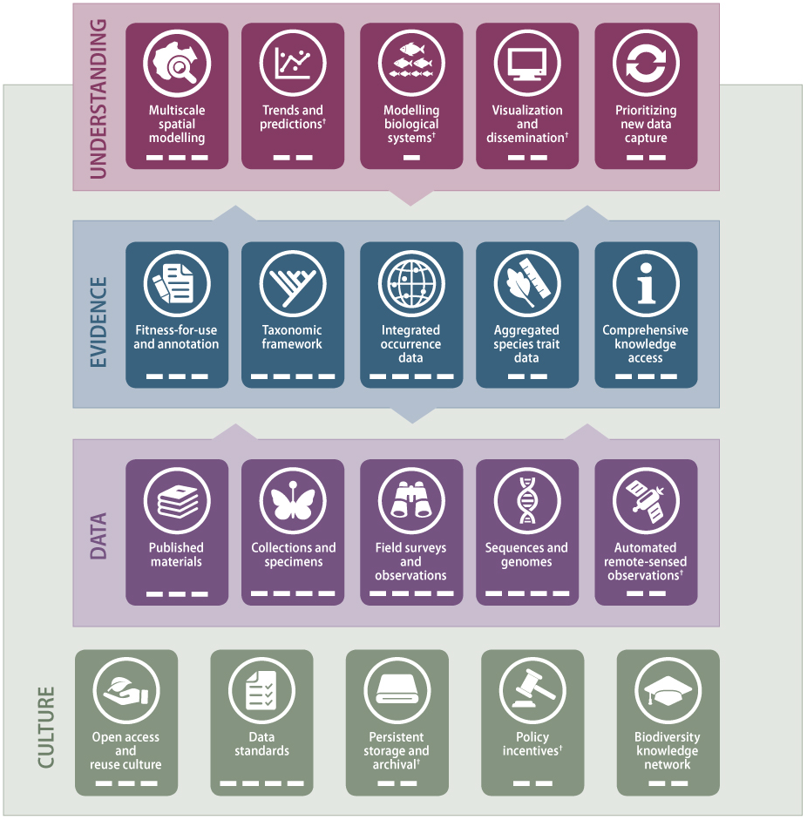
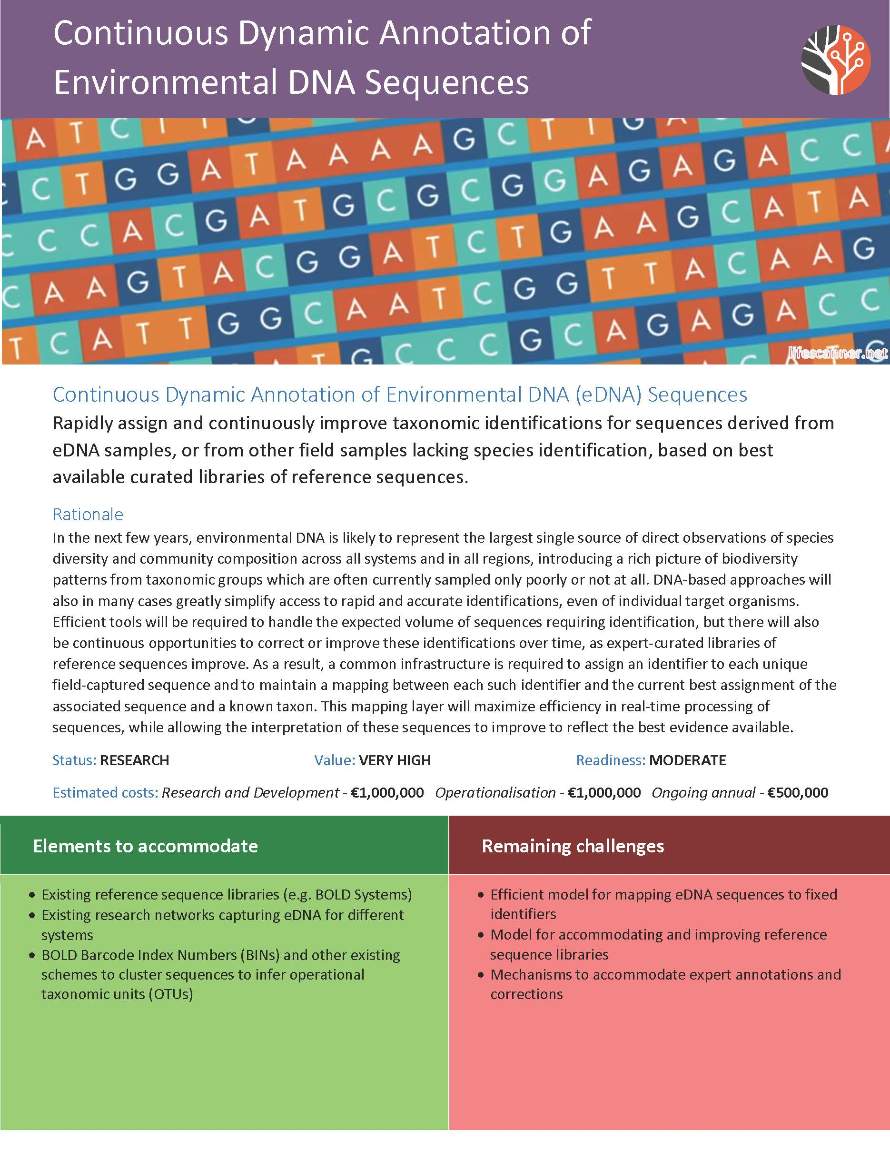
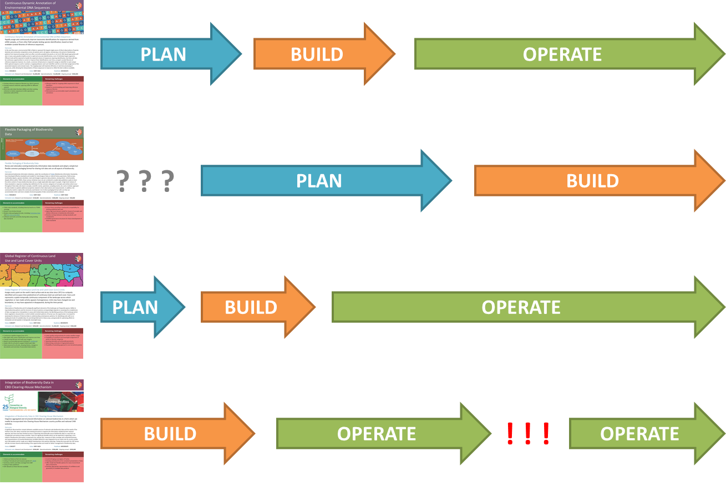
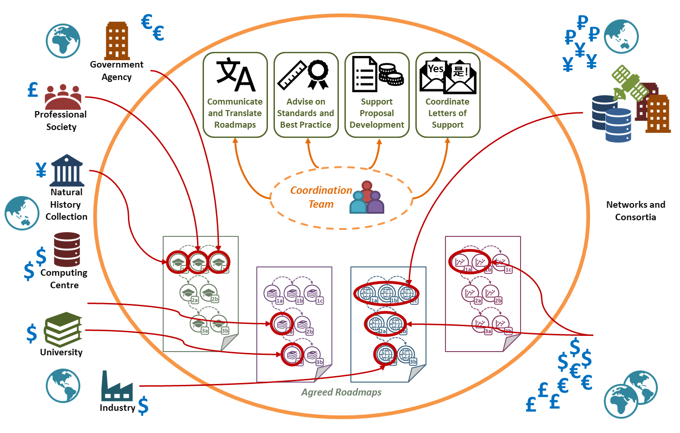
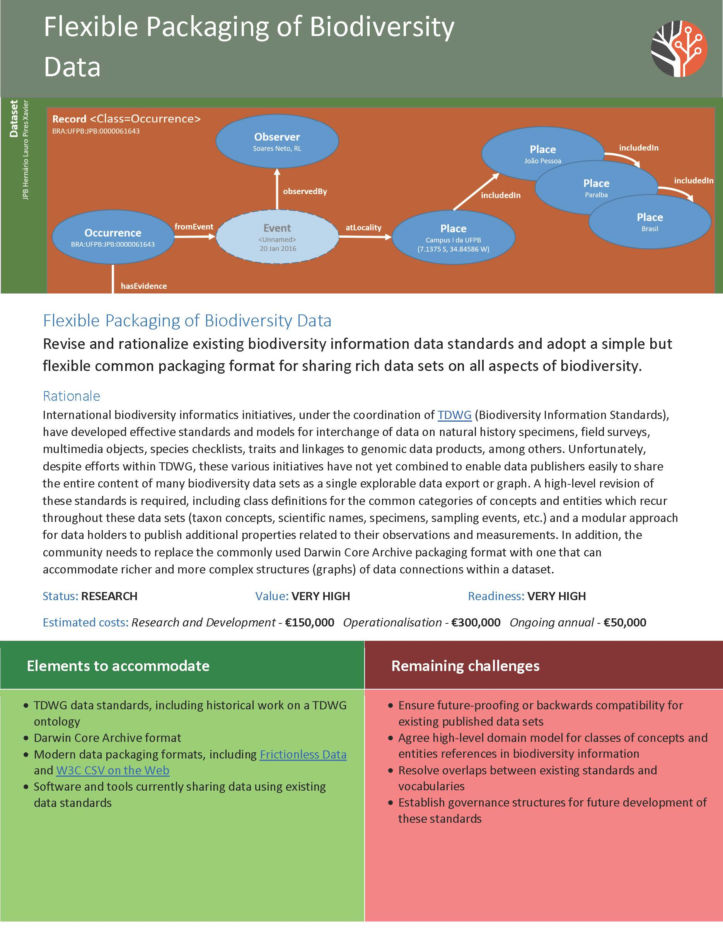
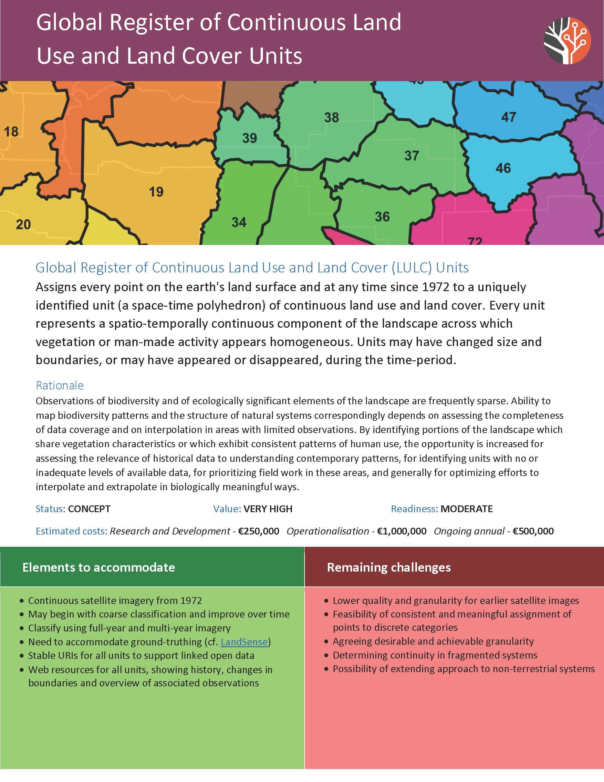
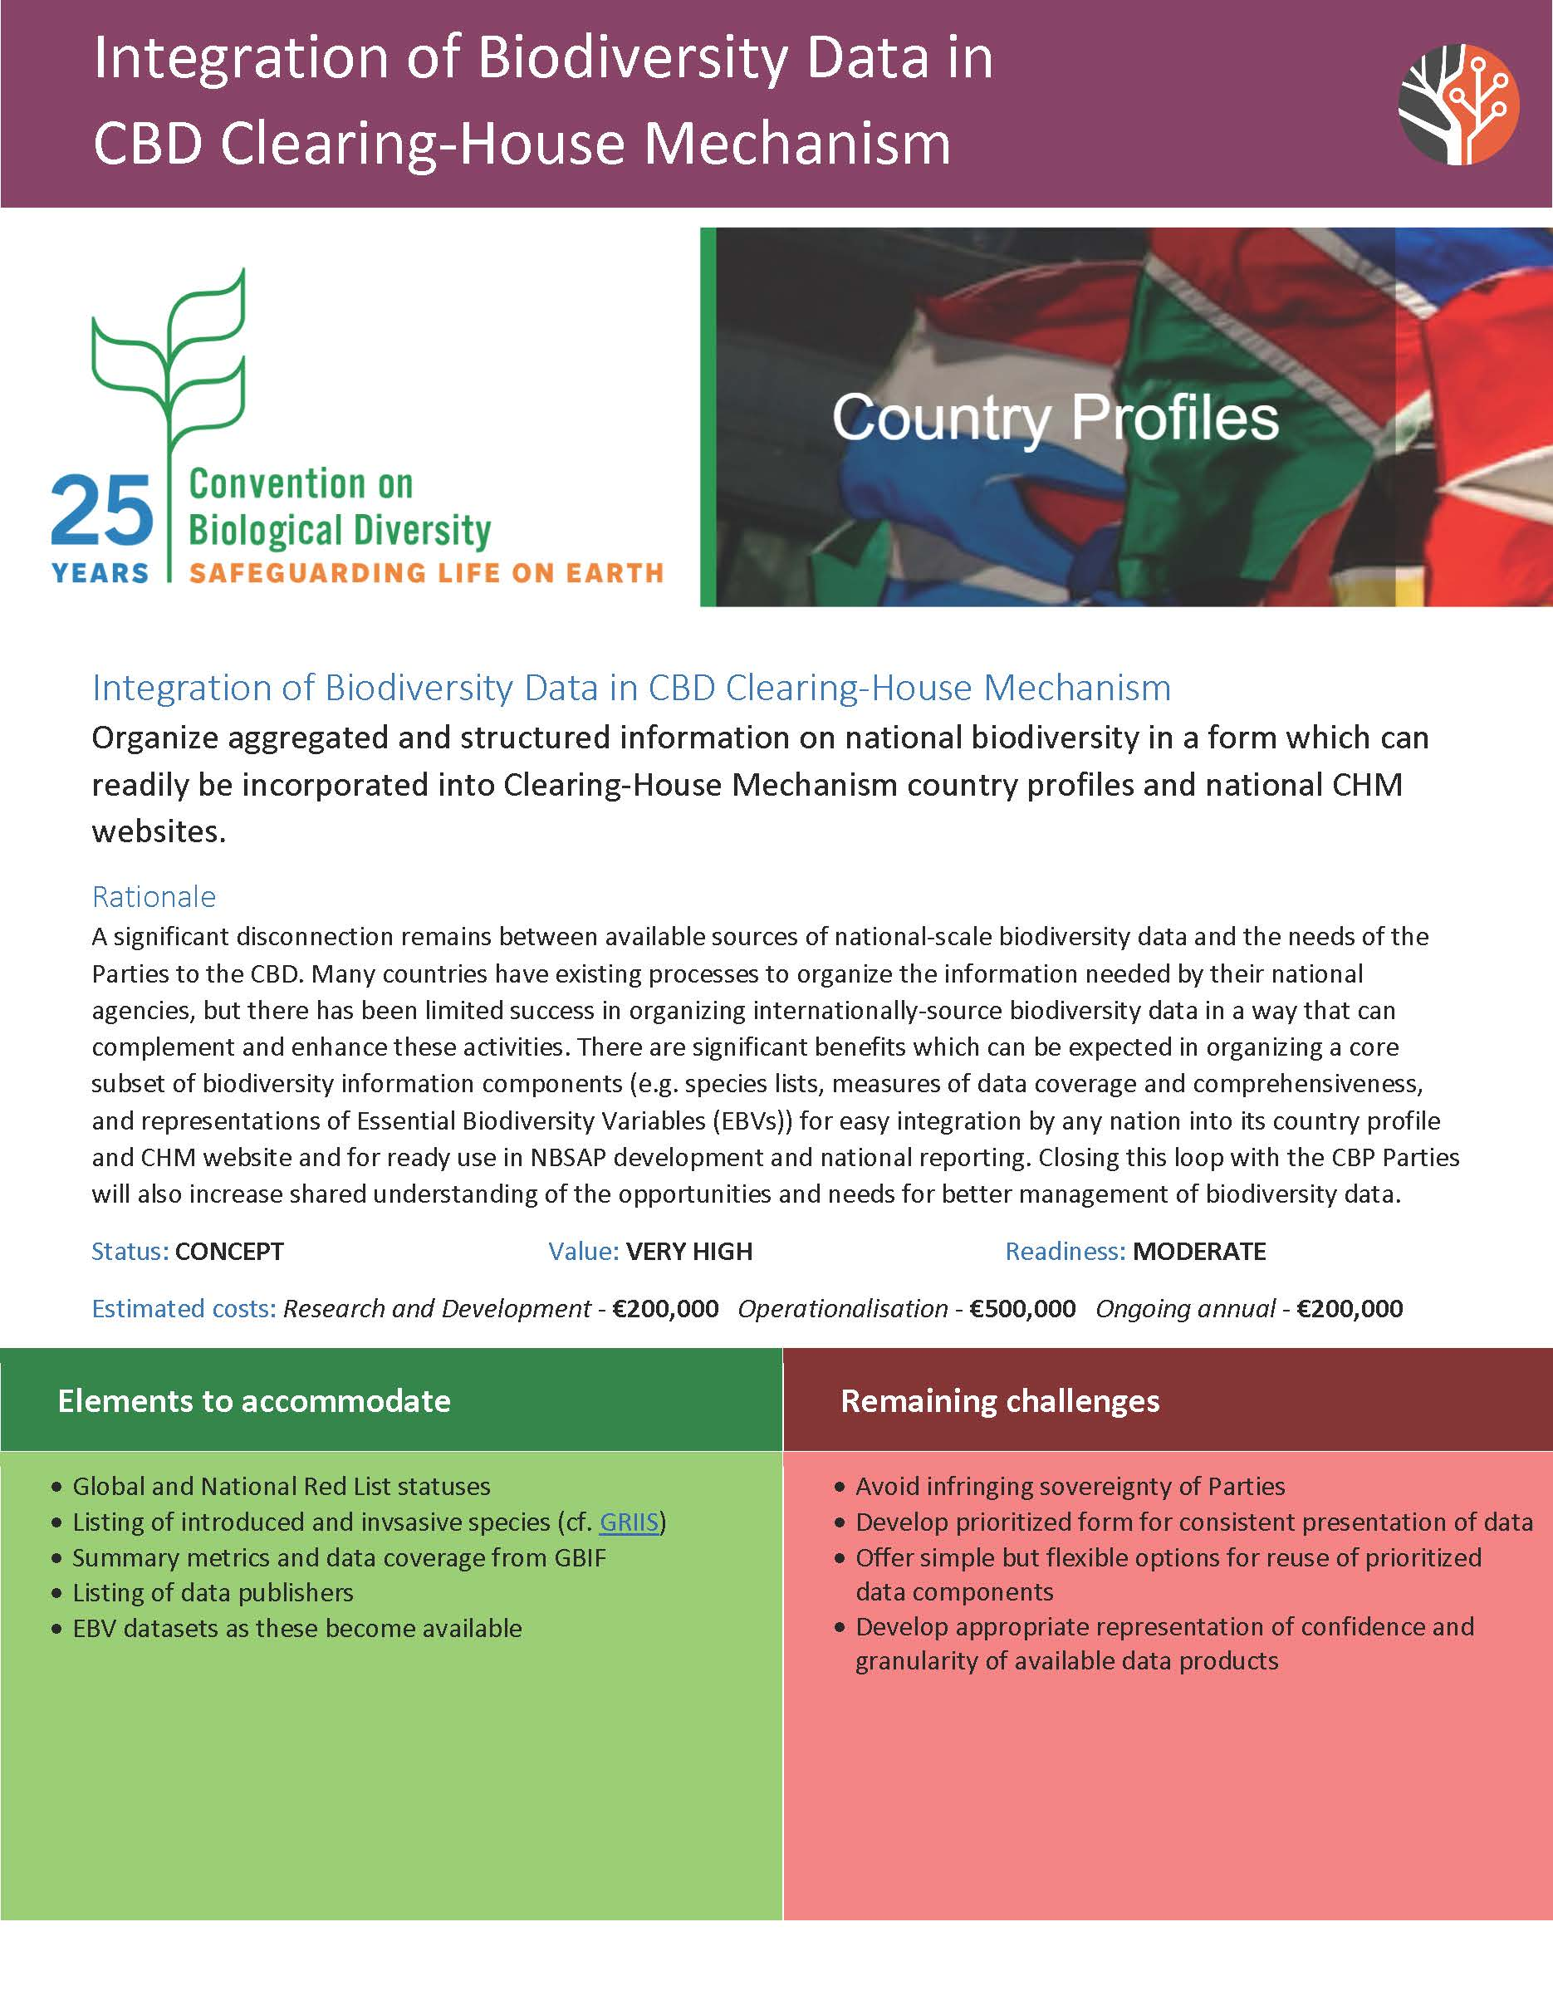
How MUCH COORDINATION IS POSSIBLE?
EASIER
HARDER
Shared vision
Shared language
Shared vision
Shared language
Shared priorities
Shared vision
Shared language
Shared priorities
Shared reporting
Shared vision
Shared language
Shared priorities
Shared reporting
Shared funding
Shared delivery
Shared sustainability

Slide 11
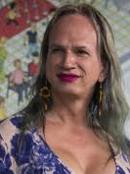
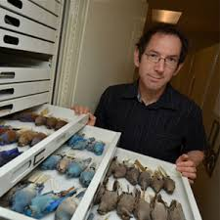
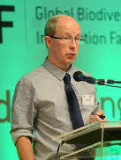
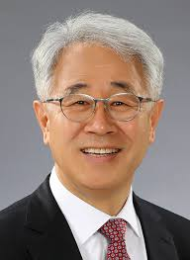
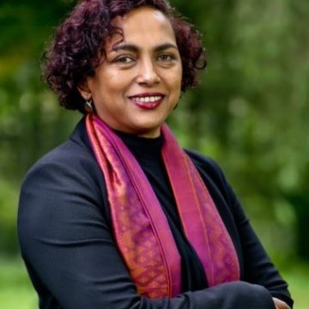
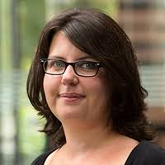
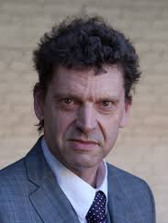
Steering Committee
Brigitte Baptiste
Alexander von Humboldt Institute
Colombia
Rob Guralnick
Florida Museum of Natural History
USA
Donald Hobern
GBIF Secretariat
Denmark
Eun‐Shik Kim
Kookmin University
Korea
Isayvani Naicker
African Academy of Science
Kenya
Laetitia Navarro
German Centre for Integrative
Biodiversity Research (iDiv)
Germany
Edwin van Huis
Naturalis
Netherlands

Slide 12
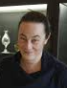

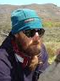
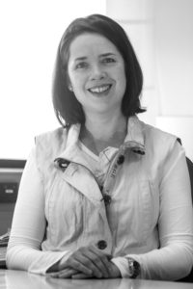
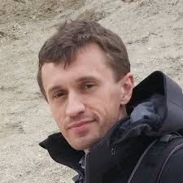
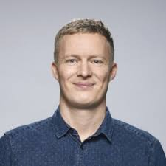
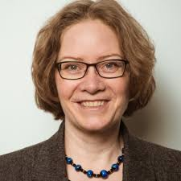
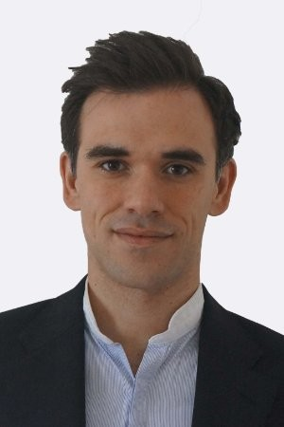
Session Facilitators
Michelle Price
Conservatoire et Jardins Botaniques
de Ville de Genève
Switzerland
Carolyn Sheffield
Smithsonian Libraries
USA
John Wieczorek
University of California, Berkeley
USA
Melodie McGeoch
Monash University
Australia
Dmitry Schigel
GBIF Secretariat
Denmark
Daniel Noesgaard
GBIF Secretariat
Denmark
Andrea Hahn
GBIF Secretariat
Denmark
Andrew Rodrigues
GBIF Secretariat
Denmark

Slide 13













SPONSORS

